Slide 1
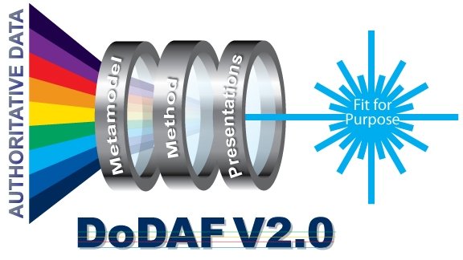
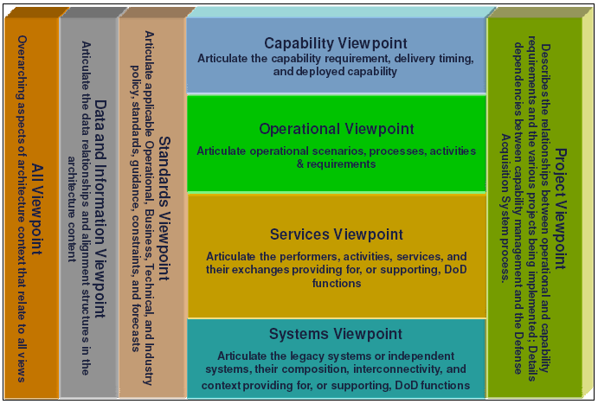
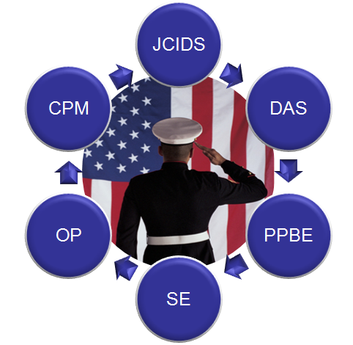
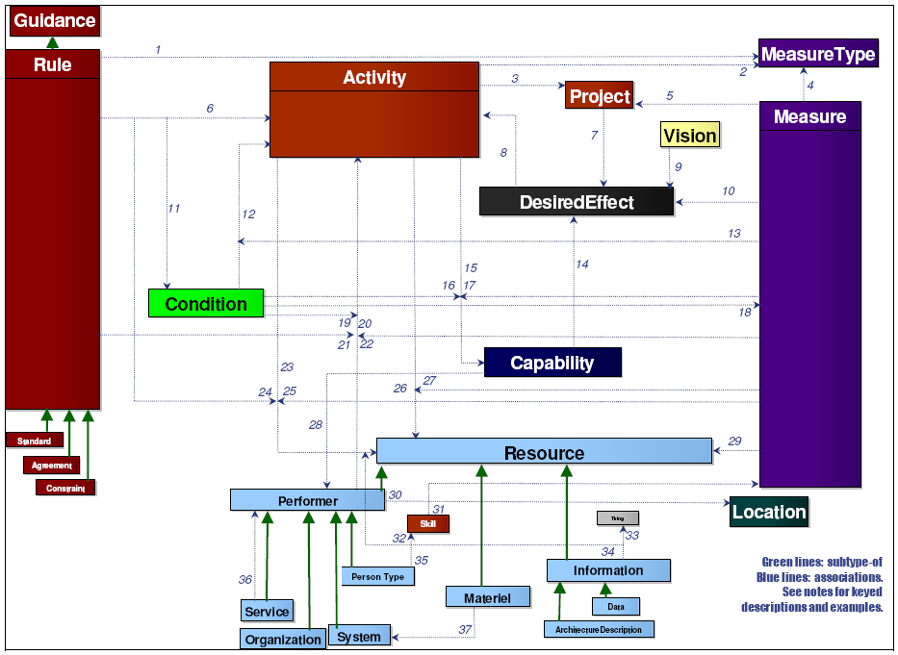
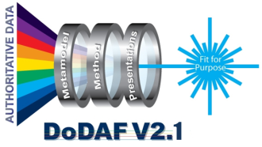

DoDAF 2.0 Work Group Roadmap
Data-centric Exemplars
FfP Presentation Views
Viewpoint/Metamodel Cross-Check
Model Refinement
VALIDATION
INTEGRATION
EVOLUTION
Viewpoint-Metamodel Cross-Check
Improve model descriptions using new
DM2 terms and relationships
Apply new DM2 rules to models
Validate DM2 against analysis
requirements and use cases
Develop process-specific use case
exemplar for Dept. six core processes
Update DoDAF website
Benefits
  Practitioner ease of use
  Guidance for the “decision maker”
  Better specifications for tool vendors
  Direction for the core process owners
Department’s Core Process Areas
Data
Viewpoints
Supported
  Streamline Model descriptions
  Validate and verify DM2 against the model
  requirements
  Create model-specific logical data model views
Install and rollout DM2 conformant repository tools
The Essential DoDAF
  Build out Exemplar in DM2 conformant repository tool
  Develop all DoDAF described Models
  Develop Fit for Purpose Presentation Views
    At least one of each type
Populate DM2 conformant database from models
  Develop analysis use case scenario
  Create Fit for Purpose Views in context of use case
  Populate DM2 conformant database from models
Generate PES XML from DM2 conformant database
Drives
DoDAF
DoD
Conceptual
Model
DoDAF 2.1:
Evolutionary Themes
  Process-specific FfP Pres Views
  Viewpoint Model Patterns
  Core Process Use Case Exemplars
  DoDAF Data Federation
2012 - DoDAF 2.1 Beyond Architectural Borders
2010 – Build out repository-based Exemplars
2011 – Create tighter integration between Viewpoints and DM2
Toll Gate 1
Toll Gate 2
Toll Gate 3

