Slide 1


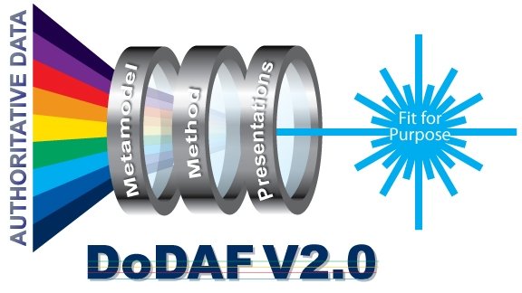
DoD Architecture Tools
5 January 2012
DoDAF Team
Notes:
1
1

Slide 2
Outline
Levels of Conformance
Tool types
Primary Functionality
Principal Application
Type of Architecture
Analytics Supported
Tool Voluntary Participation List on DoDAF-DM2 WG site

Slide 3
Four levels of conformance with DoDAF-DM2
Level 1 -- Conceptually conformant
Level 2 -- Logically conformant
Level 3 -- Physically conformant
Level 4 -- Semantically conformant

Slide 4
Four levels of conformance with DoDAF-DM2
Level 1 -- Conceptually conformant
Uses DoDAF terms and aliases (from DM2 CDM) to categorize its concepts
DoDAF views (AV-1 thru DIV-3) have correct information according to “monster matrix”). For example:
An OV-2 with radios would be non-conformant
An OV-4 with Tank parts would be non-conformant
Fit-For-Purpose (FFP) would have to be conformant with whatever the FFP model creator(s) specified, e.g., a “xV-1" view for which the creator(s) specified the model as Services mapping to Capabilities should have Services and Capabilities and the relationship but shouldn't have unrelated info

Slide 5
Four levels of conformance with DoDAF-DM2
Level 2 -- Logically conformant
Level 1 + adheres to terms and relationships from DM2 LDM and aliases
Level 3 -- Physically conformant
Level 2 + expressed as DoDAF – DM2 PES that can be consumed by others
Level 4 -- Semantically conformant
Level 3 + IDEAS semantics are correct

Slide 6
Tool Categories

Slide 7
Voluntary Participation Tools List
7

Slide 8
Voluntary Participation Tools List
8

Slide 9
Voluntary Participation Tools List
9

Slide 10
Sources for Tools Usage in DoD
DARS AV-1’s
Required by DTM 08-93 and CJCSI 6212.01E
Field for tools used
Free text field, often not filled
ISP Database
~200 ISP’s submitted to JCS in past two years
DoDAF Team in-process of procedure to gain database access for further analysis

Slide 11
600 AV-1s in DARS

Slide 12
Next Steps
Describe the four conformance levels into DoDAF 2.03
Continue maintenance and publication of voluntary tools database
Refine the tool categorizations based on inputs from community
Continue analysis of tools usage in DoD

Slide 13
Questions?

