Slide 1
Department of Defense (DoD) DoD Architecture Education and Training DoD Architect’s Competency Framework Prepared for DoD Architecture Framework (DoDAF) Version 2.0 Plenary 5 January 2012
Walt Okon
Senior Architect Engineer
Architecture & Infrastructure Directorate
Office of the Secretary of Defense
E-Mail: walt.okon@osd.mil

Slide 2
DoD Architecture Education and Training
The Question:
What are the skill-sets necessary to contend with the challenges facing federal agencies today, including funding and cyber-security?

Slide 3
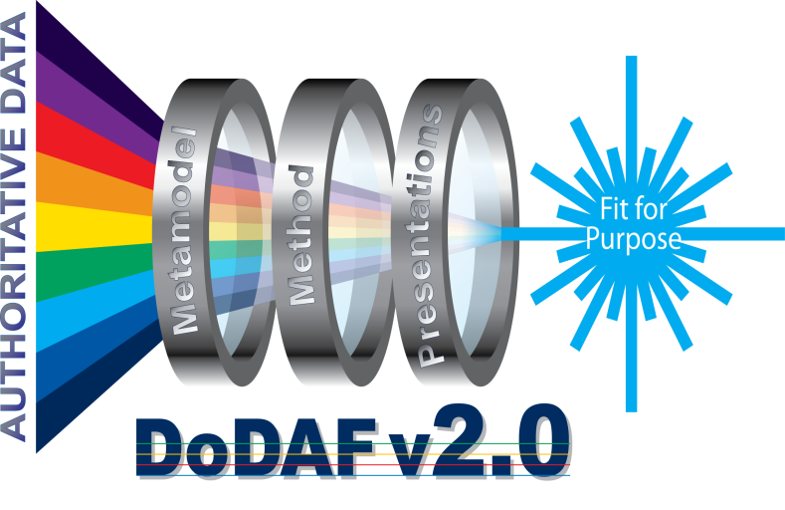
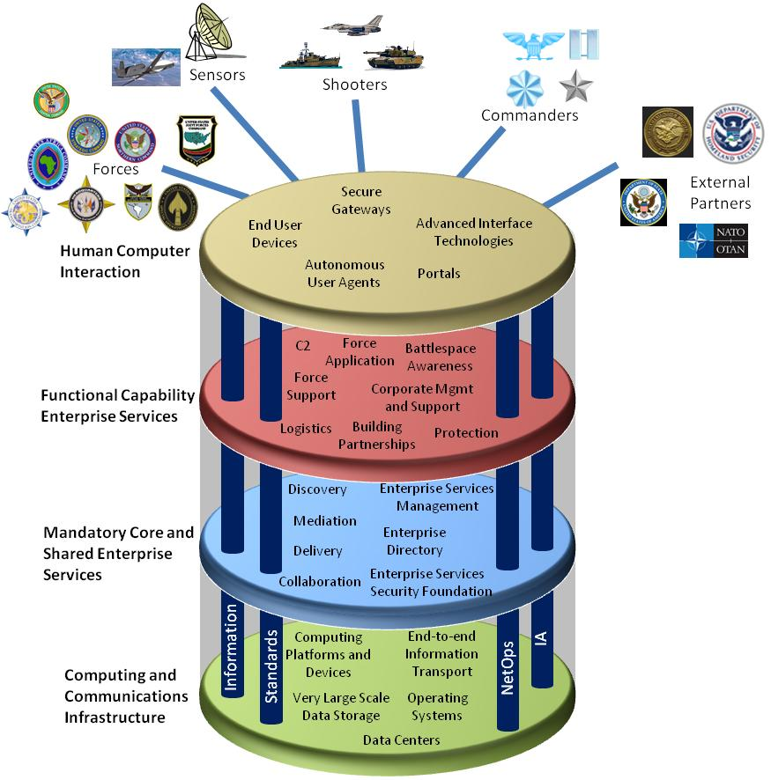
Elements of Quality Architecture
Single Architecture Framework
Policy, Direction, Guidance
Exchange
Architecture Tools
Certified Architects
Enabling efficient and effective acquisition of hardware, software and services used by DoD in missions
Common Architecture Framework Approach
Notes:
3

Slide 4
Architecture Education & Training
Certified Enterprise Architects design the information technology architecture structure enabling the efficient and effective acquisition of hardware, software and services utilized by the DoD in missions supporting the warfighters.
Common Architecture Framework
Notes:
4

Slide 5
Purpose
To create a Empowered Architect’s Workforce.
To Identify the knowledge, skills, abilities, and functions an architect in the DoD is expected to exhibit to ensure success at every stage in an architecture life cycle.
5

Slide 6
Objectives
Review current official government policy, direction, and guidance on Architecture Career Paths.
Coordinate policy, direction, and criteria for development and implementation of Architecture Career Path.
Provide sharing best standard practices and development of enterprise and solutions architectures.
Provide architecture competencies which support the United States Government (USG) Common Approach as defined by the Office of Management and Budget (OMB).

Slide 7
Accomplishments
Charter
POAM
Guidance Outline
Competency Framework Pilot Program
Working with the Office of Personnel Management (OPM) for Mission Critical Occupation (MCO)

Slide 8
Way Ahead
Competency Framework Pilot Program
Career Path Guidance Document

Slide 9
Five Key Stakeholder Groups
DoD employees
Supervisors
Hiring managers/
Human Resources
Program managers
Architecture Education
and Training providers

Slide 10
Architect’s Titles
Organizational or functional titles for positions include:
Chief Enterprise Architect
Senior Enterprise Architect
Enterprise Architect
Information Technology Architect

Slide 11
Roadmap to Certification
OBJECTIVE: Publish, implement DoD Architect’s Career Path
OBJECTIVE: Publish, implement DoD Architect’s Career Path
OBJECTIVE: Deliver DoD Architect’s Competency Framework
Define competencies at each level
Define types of architecture
OBJECTIVE: Complete DoD Architect’s Competency Framework Version 2.0
Engage Industry and Academia
OBJECTIVE: Describe Architecture Education & Training
EA Conference
Career Path
Refine
Competency: Develop White Paper
Levels of Architecture
Knowledge, Skills Ability
Approved
Certification
Merge
Competencies
v2.0
Publish
Competencies
EA Conference
EA Conference
EA Conference
EA Conference
EA Conference
EA Conference
2008
2009
2010
2011
2012
2014
Notes:
With IEA 2.0 the IEOA will be retired as a guidance document.

Slide 12
Way Ahead
Surveying
Research Analysis
Build Partnerships
Career Path Guidance Document
Career Path White Paper
Competency Framework v 3.0

Slide 13
Education & Training Partnerships
National Defense University
DoD Defense Universities
Penn State/George Mason University
FEAC
EA-SIG
Tool Vendors
Office of Management and Budget (OMB)

Slide 14
Enterprise Architecture Fundamentals Course
The EA Fundamentals course consists of two intensive-resident sessions:
The first session examines enterprise architecture (EA).
The second session explores the use and effectiveness of architectural modeling.
Special points of interest of this training experience:
Gain understanding of DoD’s approach to enterprise architecture.
Find out how key EA components and guiding principles are shaping the future of EA training and education.
Potentially gain college credit toward a Master’s Degree.
Network with enterprise architects from across Dodd.
Enrollment POC:
Matt Newman: newmane@ndu.edu

Slide 15
Enterprise Architecture Fundamentals
DEADLINE FOR NOMINATIONS IS February 1, 2012!
Special Points of interest of this educational experience:
Gain understanding of DoD’s and Intelligence Community’s (IC) approach to enterprise architecture (EA)
Develop EA modeling skills and the ability to systematically assess model quality
Potentially gain college credit toward a Master’s Degree
Network with enterprise architects from across DoD and the IC
Don’t miss out on the exciting educational opportunity. See page 2 for complete registration details!
Key Educational Performance Outcomes
Participants in this educational course will be able to:
Describe the nexus between enterprise architecture (EA) and successful enterprise planning and execution to advance mission performance
Identify EA’s role in facilitating other critical agency activities, e.g., capital planning and investment control (CPIC) and information assurance
National Defense University's iCollege offers fresh, informative Enterprise Architecture Education
Explain the application of EA models, identify strategies to address the challenges of EA adoption, the use, and institutionalization
Assess the EA maturity of an organization and an EA program and interpret both object-oriented and structured-based modeling methods and the primary characteristics of a model in order to critically assess its quality and the information being depicted.
EA Fundamentals Course
THINKING OF ENROLLING?
STEP 1: Review workshop calendar and assess time commitments.
STEP 2: Qualified individual nominated by supervisor before deadline.
STEP 3: NDU iCollege registration process completed – student receives pre-read assignments
STEP 4: EA Fundamentals Workshop begins!
The EA Fundamentals course consists of two intensive resident sessions. The first session examines enterprise architecture (EA) as a strategic capability organizational leaders use for enterprise planning, decision-making, and key process execution. Students explore leadership competencies needed to advance EA adoption, use, and institutionalization. Students also explore integration of EA with governance, strategic planning, budget, capital planning, IT portfolio management, and information assurance. Students examine EA descriptive frameworks and associated models that guide EA development activities and review EA evaluative frameworks use to assess organizational EA management capacities and performance outcomes enabled by the EA. Students further examine challenges to organizational adoption, implementation, use, and institutionalization and consider strategies to address them.
The second session explores the use and effectiveness of EA models to describe an organization and examines model-based products as tools to support, influence, and enable organizational planning, and decision-making. Hands-on exercises provide students with practical experience with work-products common to the DoD Architecture Framework (DoDAF) and Federal Segment Architecture Methodology (FSAM), as well as other established frameworks. A case study approach focuses on object-oriented models, e.g., Unified Modeling Language (UML) covering process, data, and systems. Structured models, e.g., IDEF, are also examined. Emphasis is placed on the efficacy of modeling styles and the interpretation of the descriptive models as well as interpreting case-study documentation. Students use an automated modeling tool to develop the descriptive models and to demonstrate the utility of an EA repository.

Slide 16
The DoD Nomination and Registration Process – Getting Started
STUDENT ELIGIBILTY
There are several key criteria that each student must meet:
The DoD candidates must be a GS12 or O-4 or above.
Bachelors Degree from an accredited institution
Nomination must be submitted though, and validated/approved by the applicant’s supervisor.
For the second session be able to install the provided EA repository tool (ProVision) on either a personal computer or on a Government unclassified computer (with appropriate agency approval). The software is compatible with Windows XP, Vista, and Windows 7 (no Mac) and requires 10MB of space.
ENROLLMENT
The first step is to consult the calendar and maker sure the candidate is able to participate in and successfully complete al the associated activities for course
Next, the interested candidate discusses the certificate course with their immediate supervisor, making sure of the fit as well as the minimal eligibility criteria are met. The supervisor then nominates the candidate via email to:
For more course information:
Matt Newman
newmane@ndu.edu
202.685.2693
TUITION
Tuition is free to all DoD employees and military. Students and/or their agencies are responsible for any incurred travel, local transportation or TDY costs.
Contractors who meet eligibility requirements may participate, but a fee of $4,100 is required (Contact Matt Newman)
COURSE CREDIT
This course may be taken for college credit towards:
The iCollege’s first level EA certificate
The iCollege’s master’s program
Master programs with our 30 plus partnering Universities (must complete the EA or CIO certificates).
Help shape the Enterprise Architecture future of the DoD. Submit your nomination today!
TRAINING LOCATION
National Defense University
iCollege, Marshall Hall
Fort Lesley J. McNair
300 5th Avenue SW
Washington, DC 20139-5066
This is a graduate level education program and not a training course. There is a time commitment for students both in the classroom as well as for independent assignments outside of the classroom.
COMMITMENT ESTIMATES
Accepted nominees are required to participate in and successfully complete all of the following:
Space is limited. Speak with your supervisor TODAY!
First Session
March 19 – April 1, 2012*
Complete preparation session work
Estimated Level of work: 20 hours
April 2 – April 6, 2012**
Participate in classroom education
Estimated level of work: 50 hours
April 7 – April 30, 2012*
Complete post-course assessment
Estimated level of work: 60 hours
Second Session
May 21 – June 3, 2012*
Complete preparation session work
Estimated Level of work: 20 hours
June 4 – June 8, 2012**
Participate in classroom education
Estimated level of work: 50 hours
June 9 – July 2, 2012*
Complete post-course assessment
Estimated level of work: 60 hours
Deadline for Nominations is February 1, 2012
*on-line ** in-resident

Slide 17
2012 DoD Enterprise Architecture Conference Save the Dates
30 April – 3 May 2012
Hyatt Regency Miami
www.DoDEnterpriseArchitecture.org

Slide 18
Questions

