Slide 2
Agenda
Federated Enterprise Architecture Vision
Pilot Objectives & Use Case
Pilot Overview
  Technical Environment
  DM2 to BEA and DIEA Mappings
Lessons Learned & Next Steps
DM2 Ontology Effort Summary

Slide 3
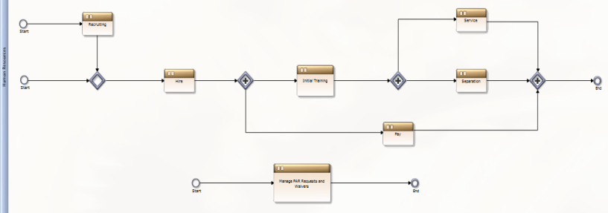
Federated Enterprise Architecture Vision
GIG
NCES
User executes BP
OMG Primitives Conformance class 2.0
BP models uniformly described
BP executes via DoD CIO directly
DoDAF 2 Metamodel: DM2
BEA Domain Vocabulary
SameAs
Query DoD/Mission Partners directly:
UK Domain Vocabulary
SameAs
Enterprise analytics
Compliance
IRB/portfolio management
WMA Domain Vocabulary
DIMA Domain Vocabulary
SameAs
SameAs
DIEA Domain Vocabulary
(Identity & IA)
(Infrastructure)
Secure Access
Services
Software
Profile
Attribute
Telcon
Platform
W3C Open Standards Legend:
Data described in RDF
Relationship described in OWL
DoD Authoritative Data Source

Slide 4
Pilot Objectives and Use case
Common vocabulary
Consistency
Analytics/Decision support
Interface to ADS
Linking data concepts across domain vocabularies using OWL
Use of industry standards
Federated SPARQL queries
Architecture “cross-walk”
Reuse
Federation Pilot
DM2
Architecture Federation
Semantic Federation
Use Case - Federated Defense Business System Compliance Process using the BEA and DIEA as the authoritative sources of compliance requirements

Slide 5
Federation Pilot Environment
Primary
DIEA
Content
DM2
BEA
Content
Alternative
User view
DM2 Ontology
Query Distributor (“Sparqlizer”)
Security / Middleware connectivity layer
API
API
SPARQL EP
Exposed SPARQL EP
BEA Metamodel
DIEA Metamodel
DIEA Content
BEA Content
DIEA
SQL
BEA
SQL/EE
Systems Architect
Modeling Tool
Systems Architect
Modeling Tool

Slide 6
Federation Pilot Mapping
DM2 Term | BEA Term | DIEA Term
Activity | BPM Process Definition
Activity | Operational Activity Definition | Operational Activity Definition
Agreement | DFMIR/FFMIA Definition | DIEA Constraint Definition
Agreement | LRP Source Definition | DIEA Constraint Definition
Agreement/Rule | Business Rule Definition
Data | ICOM Arrow Definition
Data | Information Exchange Definition
Service |  | Mechanism Definition
This is the foundation for the ontology that enables the federated/distributed query
Notes:
The empty rows within the DIEA column are empty because they do not apply at this time as the DIEA comprises only an Activity Node, Principles and Rules thus processes, Inputs&Outputs, and Information Exchanges do not exist in DIEA.

Slide 7
Lessons Learned & Next Steps
Lessons Learned
  Same term w/different meanings emphasizes value of semantic mapping
  Still have to select appropriate processes and activities from BEA & DIEA respectively but from a single interface
Next Steps
  Complete 1st iteration of pilot by end of January 2012
  Continue DCIO partnership to evolve pilot capabilities using Lessons Learned
  Reuse “real” business system solution architecture to expand pilot capabilities

Slide 8
DM2 Ontology Effort
Progress to date
  Sponsored joint effort to develop DM2 Ontology
  Used OWL terminology for IDEAs foundation core concepts where OWL and IDEAs describe the same concepts
    Specifically, leveraged similar concepts from the OWL language for creating Classes, Properties, and Individuals
  Started with Classes from the DM2 Conceptual Data Model (CDM) to create the initial top-level DM2 taxonomy
  Incorporated more detailed relationships and additional classes from the DM2 logical model into the DM2 ontology
Next Steps
  Refine per input from extended group of ontology experts
  Integrate lessons learned from Federation Pilot
  Continue DoD CIO collaboration and publish

Slide 9
Backup Slides

Slide 10
Federation Key Issues
Ontology Context and Usage
Ontology Federation and Registration
Source of Record (Data Source) Registration
Implicit – Inter source of record relationships
Semantic/Traditional Infrastructure Integration
Not Piloted
Partially Piloted
Fully Piloted

