Slide 1
NAVAIR Enterprise Architecture
12-Dec-11
Executive Business Process Council
Dan Slick
NAVAIR Deputy CIO

Slide 2
BLUF
This is not a business process initiative but rather intended to show how the NAVAIR Enterprise Architecture can help achieve better integration of the various process initiatives.

Slide 3
Enterprise Architecture (EA) Overview
Background
DON CIO has been leading the EA effort for 4 years and defines the EA framework. DON EA is currently in version 3.0
The goal of the EA is to link systems to the business and present these linkages in easy to understand and consistent graphical depictions.
DOD and DON CIO policy defines Business Process Modeling Notation (BPMN) as the standard method for capturing business processes.
DON CIO defined the Common Operational Activities List (COAL) as the authoritative initial source for business activities that make up the business processes.
NAVAIR’s Enterprise Architecture contains a DODAF DM2 compliant database along with a web-service front end.

Slide 4
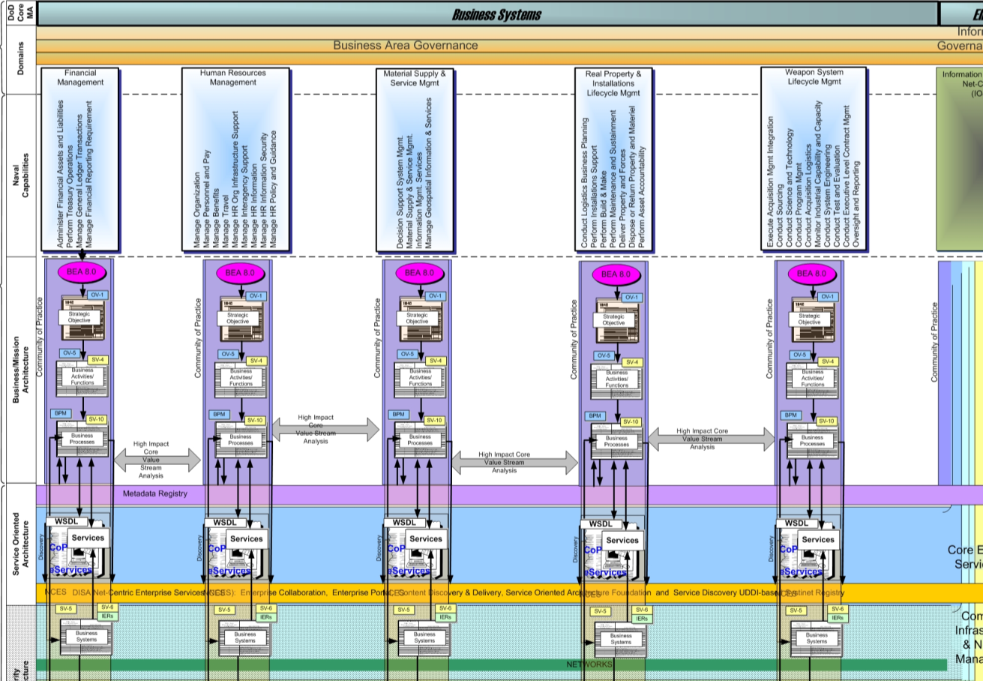
EA Framework

Slide 5
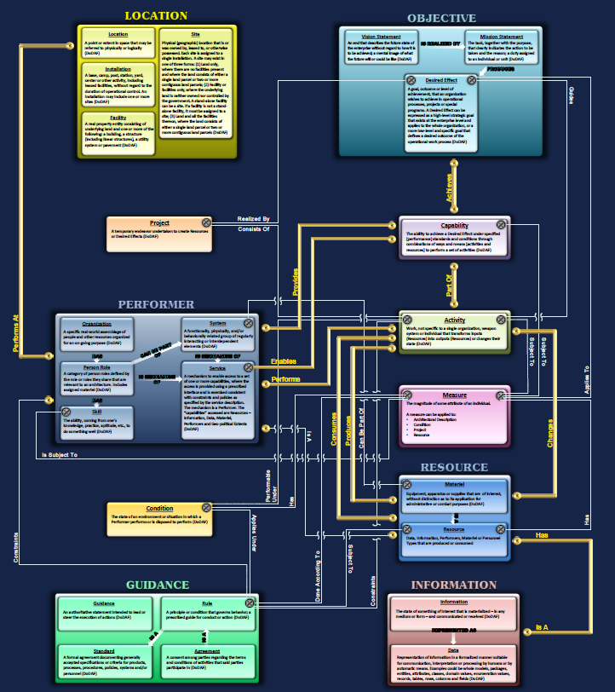
EA Design
Site
Business Objectives
Joint Capabilities
Business Processes
People
Information Technology

Slide 6
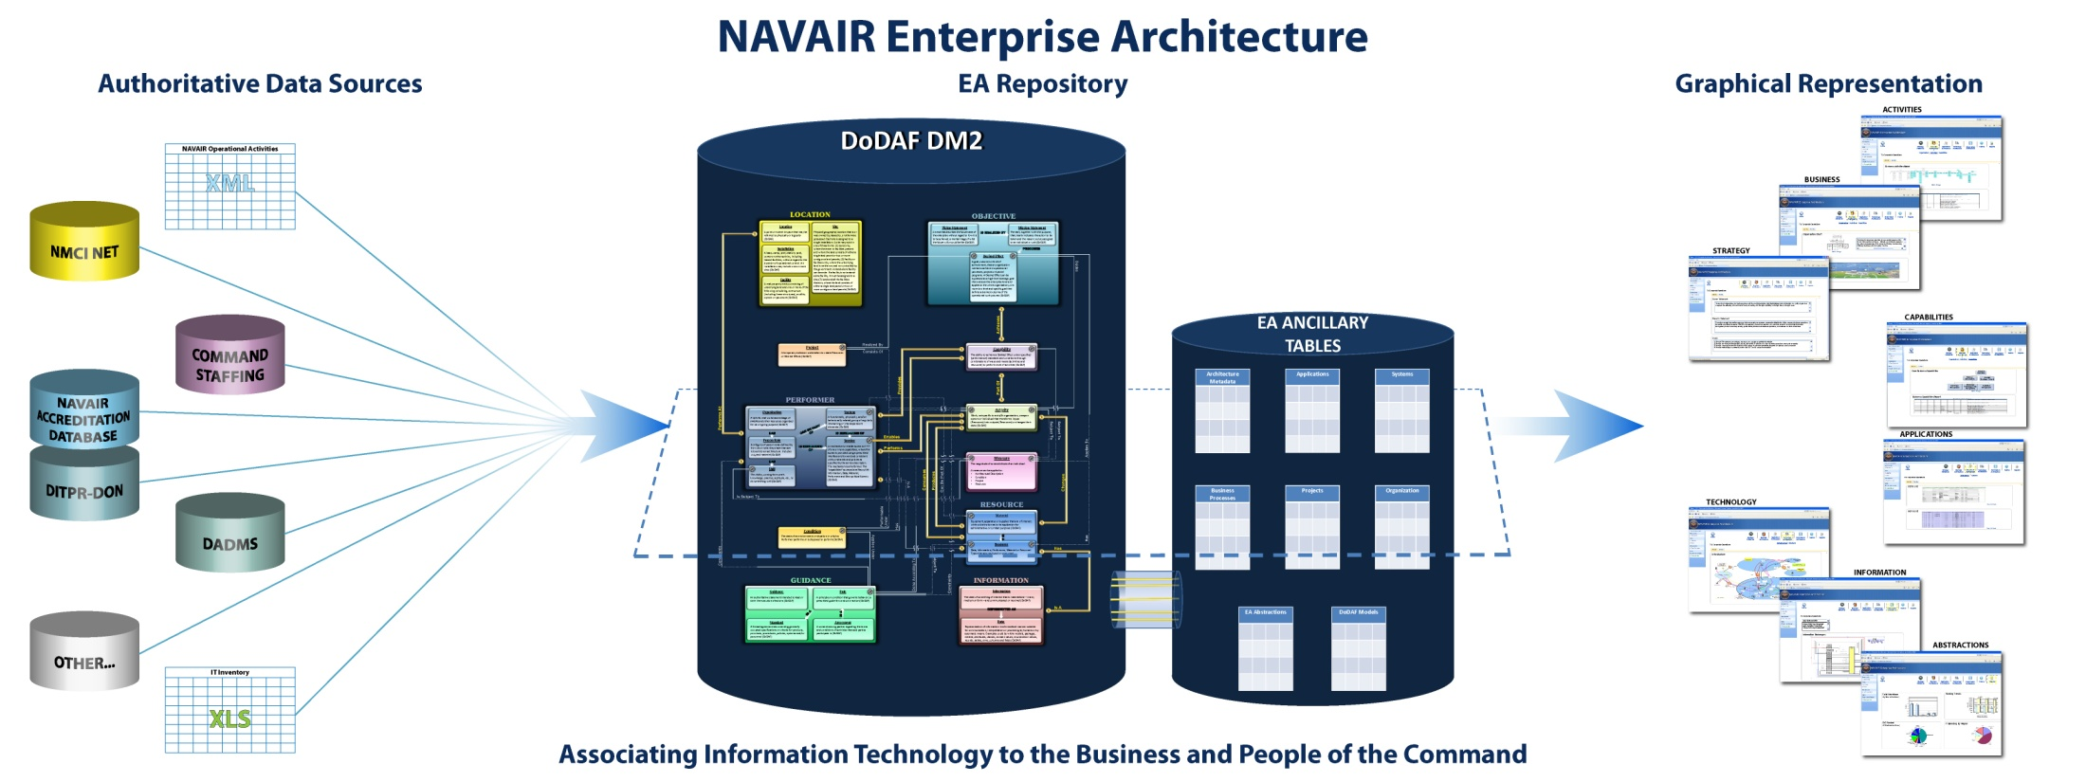
EA Design

Slide 7
Status
NAVAIR EA Status
NAVAIR is running a DODAF DM2, Program Exchange Specification (PES) compliant, Enterprise Architecture Database.
The NAVAIR EA is in an initial operational status awaiting data entry and web front end expansion.
80% of the NAVAIR business activities have been captured and are entering validation via the Competencies.
DoD has 16 E2E business processes defined with IT systems aligned at the highest level.

Slide 8
Take-Away
The DON EA framework exists.
A NAVAIR EA repository exists.
DON Policy helps standardize business processes and business activities.
Leverage as many of these tools as possible.

Slide 9
Back-Up

Slide 10
BPMN Process Model
Sample Process: Contracts
Skills associated with each process clearly defined
Program Manager
Skill:Level III
Aircraft Design
Skill:Level III
Aircraft Design
Skill:Level I
Financial database ops
Effort required identified
15.7 MHr
1 MHr
1 MHr
Develop
Statement of
Work
Develop
Evaluation Criteria
Create Line of
Accounting
Operational Activities identified
2.1.1
2.1.2
2.1.3
NIPRnet Access
NIPRnet Access
NIPRnet Access
MS Office Suite 2003
MS Office Suite 2003
MS Office Suite 2003
Desktop
PC
Desktop
PC
Desktop
PC
SAPSigma Access
Skill:Level I
Contract Cert
Skill:Level I
Contracts Cert
Skill:Level I
Contract Cert
Skill:Level III
PCO
1.3 MHr
0.5 MHr
0.5 MHr
0.5 MHr
Contracts
Warrant
Contracts reviews
Statement of
Work
Contracts review
Evaluation Criteria
Develop Program
Initiation Document
Contract Award
Contracts
2.2.1
2.2.3
2.2.4
2.2.5
NIPRnet Access
NIPRnet Access
NIPRnet Access
NIPRnet Access
MS Office Suite 2003
MS Office Suite 2003
MS Office Suite 2003
SPS V3.2
Desktop
PC
Desktop
PC
Desktop
PC
Desktop
PC
MS Office Suite 2003
SAPSigma Access
SAPSigma Access
Oracle 10.1
CONTRACTSnet
access
Network needs defined
Applications, databases associated with each process clearly defined

